Slide 1
Spend Planning: How are We Doing?
April Zhong

Slide 2
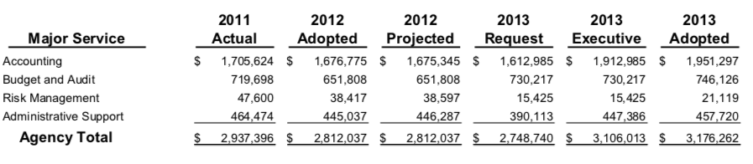
Where does the data come from ?
A source to get more data:
https://www.cityofmadison.com/finance/budget/

Slide 3
Where does the data come from ?
Five categories:
Actual budget: the actual expenditures from the prior year
Executive budget: Mayor’s plan for expenditures and funding sources
Adopted budget: Funding for the continuation of existing services
Projected budget: projected expenditures for the current year
Requested budget: the agency request for the upcoming year

Slide 4
2017
Actual budget
amendments offered by members of Common Council
2018
Projected budget
Adopted budget
Adopted budget
(budget for 2019)
2019
Executive budget
2019
Requested budget

Slide 5
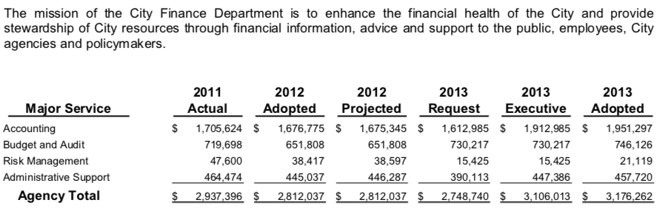
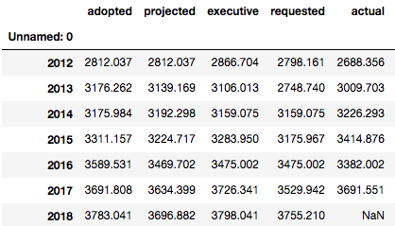
How to read a PDF ?
Python code
pdfminer
tabula
PyPDF2
modules

Slide 6
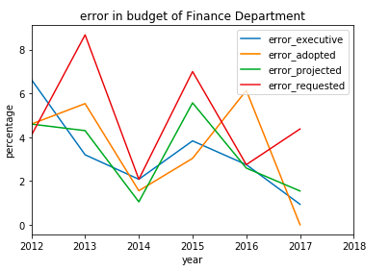
How well are we doing in budget planning ?

Slide 7
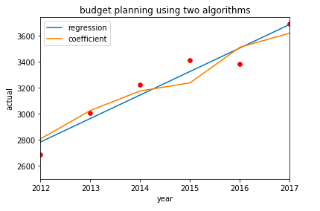
How well are we doing in budget planning ?
Regression:
y = 180.613x -360609.425

Slide 8
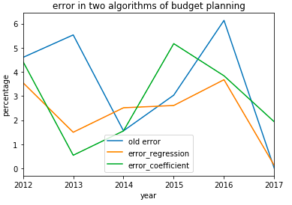
How well are we doing in budget planning ?

Slide 9
Remaining questions
Better algorithm to compute adopted budget?
Compare to some other cities?
Email: szhong45@wisc.edu

